Slide 1
Smart Nose Surgery
Team 1:
Chris Graziano, Victoria Jordan, Anton Kiselev,
Jacob Preseau, Chintan Thakrar

Slide 2
Overview
01
Video Demo
02
Individual Contributions
03
Scrum Board
04
Future Plans

Slide 3
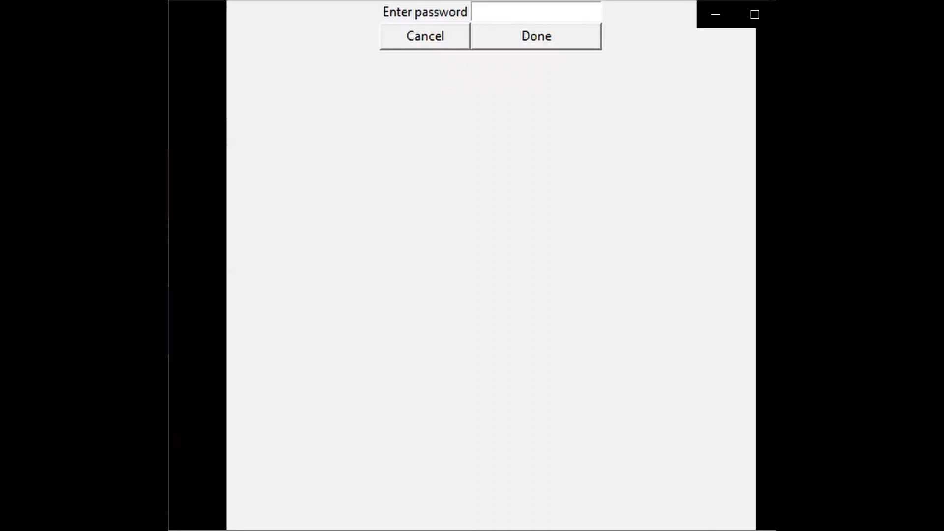
Product demo

Slide 4
Individual Contributions

Slide 5
Chris Graziano
Worked primarily on the frontend portions of the project:
tkinter application window that displays all of the images and takes the photo
MainFrame: the master
LoginFrame: houses the login window
StartFrame: Initializes the picture taking of the user
PicFrame: Shows the user their picture and asks for the K value
ClusterFrame: Shows the user a representative of every cluster
FinalFrame: Shows all the faces from the chosen cluster
ChangesFrame: Displays the changes to the nose
Notes:
I worked primarily on the frontend portions of the project.
This took the form of the tkinter application window that displays all of the images and takes the photo.
I accomplished this by creating a frame-managing master class that is used to spawn all of the frames used in the program.
Several global variables and setters were used to keep track of properties across classes.
The main tasks can be broken down into the objectives of the frames: MainFrame: the master, LoginFrame: houses the login window, StartFrame: Initializes the picture taking of the user, PicFrame: Shows the user their picture and asks for the K value, ClusterFrame: Shows the user a representative of every cluster, FinalFrame: Shows all the faces from the chosen cluster, ChangesFrame: Displays the changes to the nose

Slide 6
Victoria Jordan
Documentation Development
SRS, SDD, Test Plan
Research javascript files
JSON
Assisted with clustering frame array on app

Slide 7
Anton Kiselev
Participated in developing documentation for the product
Obtained the final face dataset
Implemented an algorithm for extracting facial features
Implemented KNN algorithm for the system
Implemented clustering algorithm based on nose type

Slide 8
Jacob Preseau
Obtained the initial face dataset
Devised a function to "normalize" nose points
Created most methods in the ComputeDistances.py file
Contributed some functionalities to the app
Assisted with documentation
Notes:
Normalize nose points - scales the points with respect to a central point on the nose, with face heights and face widths as the units.
ComputeDistances.py - added the aforementioned "normalize points" functions, as well as methods to calculate the differences between two face point arrays (one in Euclidean distance and one in coordinates).
App functionalities - Incorporated the picture taking function to the app, as well as the "Display Changes" screen that overlays a target face's nose points on top of the user's to show the difference.
Documentation - Contributed mostly to the first version of the SRS, and the final version of the SDS

Slide 9
Chintan Thakrar
Database management
Participated in developing documentation for the product
Assisted in implementing ML algorithms
Assisted in app development

Slide 10
Sprint Review and Retroperspective

Slide 11
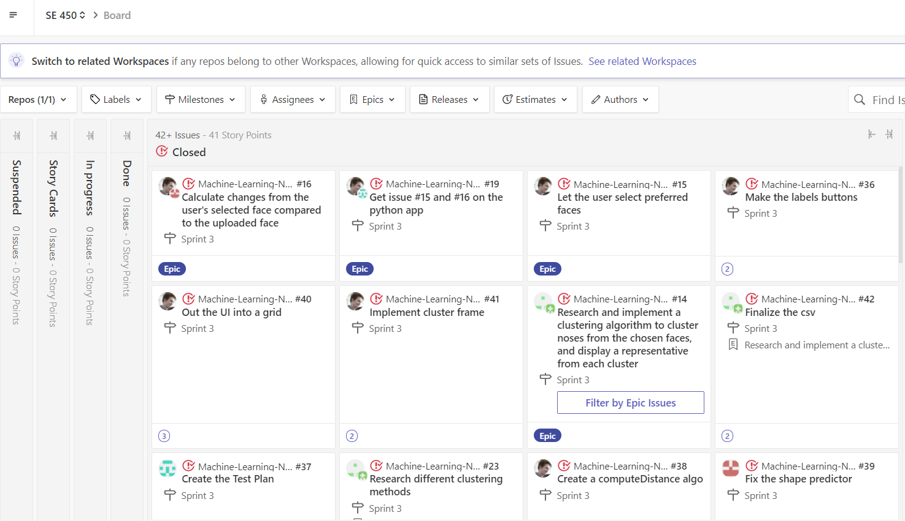
Scrum Board

Slide 12
Plans for spring 2021
Upgrade our app to work with 3D models, such as JSON.
Improve current algorithms
Improve scaling with 3D models

